Slide 1
PyDevice for Python IOC
Klemen Vodopivec, Kay Kasemir,
July 2026

Slide 2
Why Python? Why Python IOC?
Python widely adopted language, easy to learn, develop, test
  … and maintain?
Large set of readily available high-level functions
  Crunching data (numpy, scipy, etc.)
  Interfacing external sources: Databases, web services
When existing EPICS functionality doesn’t cover the new use case … but want to use robust EPICS infrastructure
  IOC shell (interactive console, commands, logging)
  Reliable CA & PVA communication
  Archives, alarms, autosave
  GUI tools

Slide 3
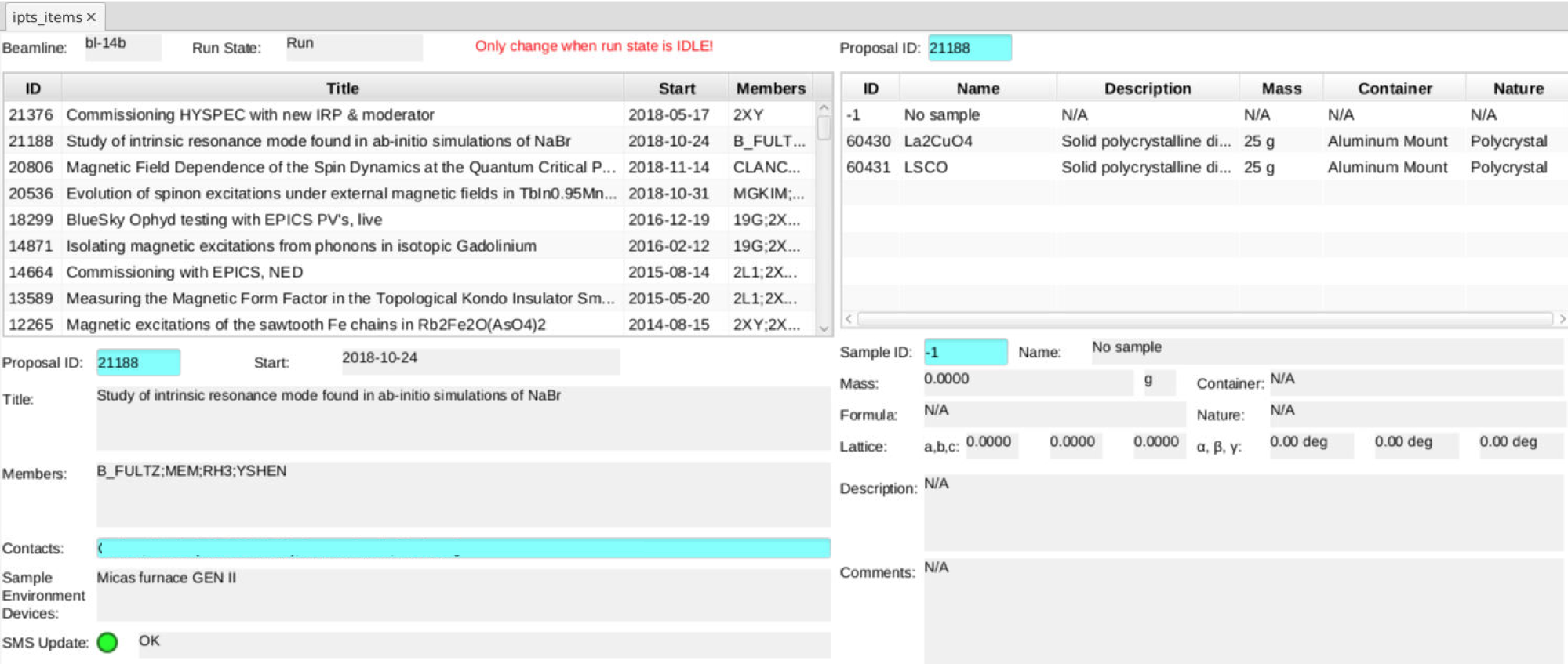
Example: Proposal Database

Slide 4
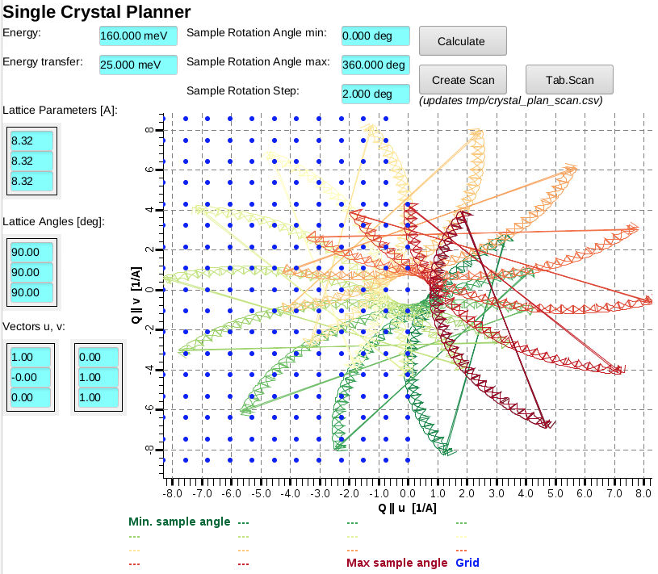
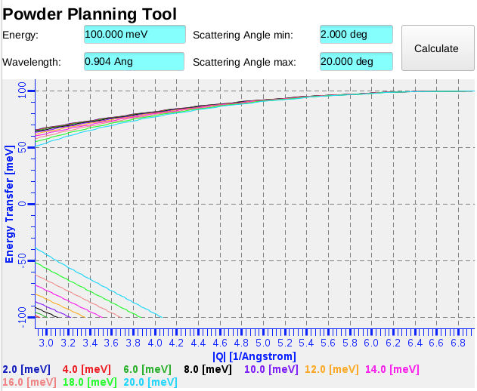
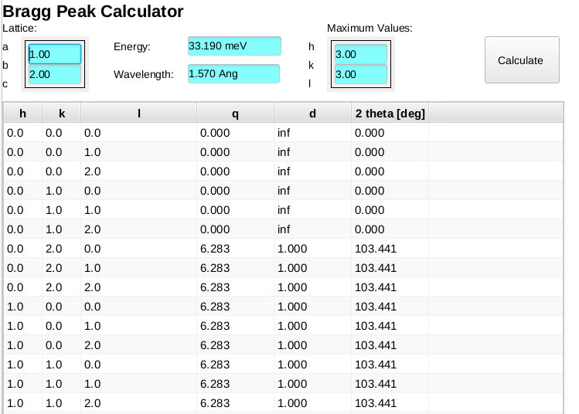
Example: Computations

Slide 5
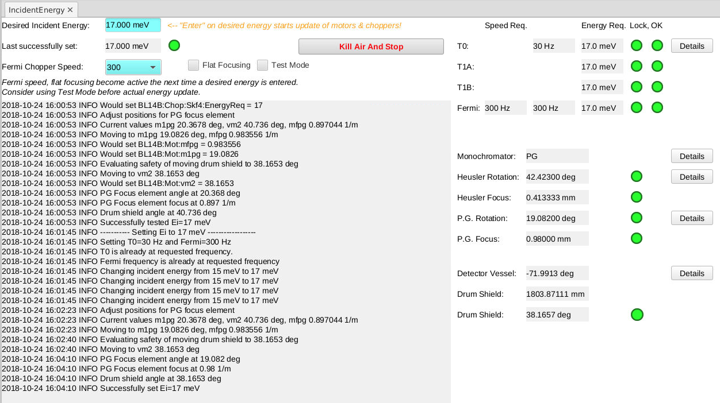
Example: Energy Adjustment
Could use sequencer, but had existing python code

Slide 6
Available Python IOC solutions
pcaspy
https://github.com/paulscherrerinstitute/pcaspy
Most mature, started in 2011
Purely in Python code
But missing EPICS goodies
  No “records”
  autosave, IOC commands
Custom records implementation
  No RTYP, EGU, SCAN etc. fields
  Affects GUI tools
pyDevSup
http://mdavidsaver.github.io/pyDevSup/
Plugs into standard EPICS IOC
Invoked from EPICS records
Invoked Python code must extend provided class
Most flexibility to update records and fields
PyDevice
https://github.com/klemenv/PyDevice
Plugs into existing EPICS IOCs
Invoked from EPICS records
Arbitrary Python code invoked from EPICS records
Can’t change record fields directly
EPICS-independent Python code
  Can be reused or tested outside EPICS environment

Slide 7
PyDevice in more details
st.cmd
pydev “import xyz”
Python inside IOC
Call from startup file
Call from records
  ai, ao, longin, longout bi, bo, mbbo, mbbi, stringin, stringout, waveform
Pass record fields to Python code
  Values evaluated when record processes
  Return value pushed to record VAL field
  Types automatically converted
Python exceptions translate into SEVR&STAT
IOC
Python
ai record
INP
ao record
OUT

Slide 8
PyDevice Example
Note time stamps of periodic
“Hello …” in IOC shell
Try this from terminal:
  caput –c –w 20 delay 10
st.cmd
﻿# Import what's used by records
pydev "from datetime import datetime"
pydev "from time import sleep"
1_hello.db
﻿﻿record(ao, "hello")
{
field(DTYP, "pydev")
field(OUT, "@print('Hello from PyDevice, it is ' + str(datetime.now()))")
field(SCAN, "5 second")
}
record(ao, "delay")
{
field(DTYP, "pydev")
field(OUT, "@sleep(VAL)")
}
/ics/examples/19_python: pyiocApp/Db and iocBoot/pyioc

Slide 9
PyDevice “pycalc” Record
New record type to support passing multiple parameters
  Similar to aSub, genSub, calc records
  But evaluate Python code
record(pycalc, "Example:gcd")
{
field(INPA, "training:pyioc:X1 CP")
field(INPB, "training:pyioc :Y1 CP")
field(INPC, "training:pyioc :X2 CP")
field(INPD, "training:pyioc :Y2 CP")
field(CALC, "gcd(A,B,C,D)")
}
record(pycalc, "Example:GetHtml")
{
field(INPA, "Example:Proto CP")
field(INPB, "Example:Hostname CP")
field(INPC, "Example:Port CP")
field(CALC, "mywebClientFetch(‘A’, ‘B’, C)")
}

Slide 10
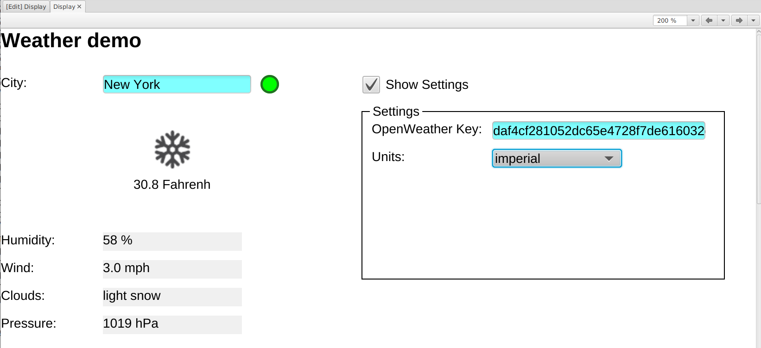
Weather demo
/ics/examples/19_python: pyiocApp/Db and iocBoot/pyioc:
Check weather.py
Study 3_weather.db
Run 3_st.cmd and weather.bob display
Why “Fahrenh”?
EGU is “Fahrenheit”, but CA DBR_CTRL_DOUBLE uses MAX_UNITS_SIZE of 8.
Fine with PVA!

Slide 11
Summary
Python with CA server & client libs can act as IOC
Great tool to have
Doesn’t replace all IOCs
PyDevice can use Python within an IOC
https://github.com/klemenv/PyDevice

